Slide 1
MODIFIED CONDITION/ DECISION COVERAGE TESTING
MUHAMMAD BILAL (02-131192-080)
RABYA ESSANI (02-131192-081)

Slide 2
WHAT IS MODIFIED CONDITION / DECISION COVERAGE TESTING?
IT IS A WHITE BOX TESTING TECNIQUE USED TO TEST HIGHLY CRITICAL SYSTEMS. IN MC/DC EACH CONDITION IN A DECISION HAS BEEN SHOWN TO INDEPENDENTLY AFFECT THAT DECISION'S OUTCOME BY VARYING JUST THAT CONDITION WHILE HOLDING ALL OTHER POSSIBLE CONDITIONS FIXED.

Slide 3
WHERE IS IT USED?
IT IS USED IN SOFTWARES WHERE PREVENTION FROM FAILURE IS AT THE MAXIMUM PRIORITY. SUCH AS THE SAFTY CRITICAL APPLICATIONS IN THE AVIONIC DOMAIN (systems including communications, navigation, display and management of multiple systems, and the hundreds of systems that are fitted to aircraft to perform individual functions).

Slide 4
WHY IS IT USED?
MC/DC PROVIDES A BALANCE BETWEEN PRECISION AND EFFORT. IT REQUIRES A MUCH SMALLER NUMBER OF TEST CASES AS COMPARED TO OTHER COVERAGE TECHNIQUES WHILE RETAINING A HIGH ERROR-DETECTION PROBABILITY.

Slide 5
WHY IS IT USED? (Continued)
WHEN WE TALK ABOUT CONDITION, WE POSSIBLY HAVE 2 OUTCOMES EITHER TRUE OR FALSE.
WHEN WE HAVE ‘N’ NUMBER OF CONDITIONS THE TOTAL COMBINATION CAN BE CALCULATED BY 2^{N}.
BUT MC/DC REQUIRES SIGNIFICANTLY FEWER TESTS WITH HIGH ERROR DETECTION PROBABILITY.

Slide 6
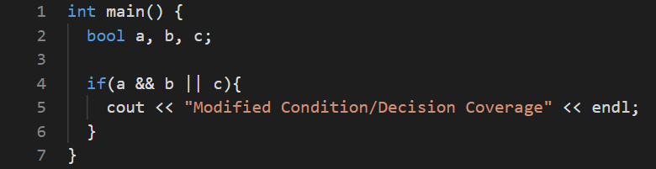
EXAMPLE 1

Slide 7
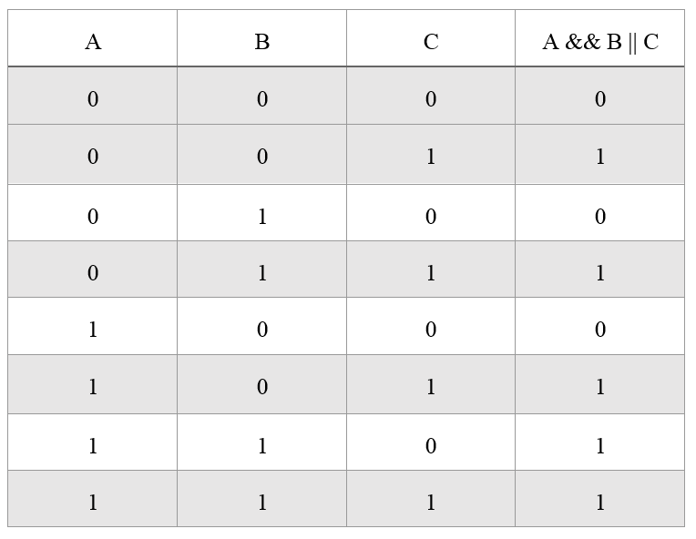
EXAMPLE 1 (Continued)
A can alter the result independently as shown in test number 4 & 8.
B can alter the result independently as shown in test number 6 & 8.
C can alter the result independently as shown in test number 1 & 2.
Hence, we will choose test numbers 1, 2, 4, 6, and 8 as our test cases.

Slide 8
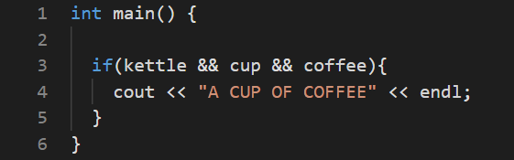
EXAMPLE 2

Slide 9
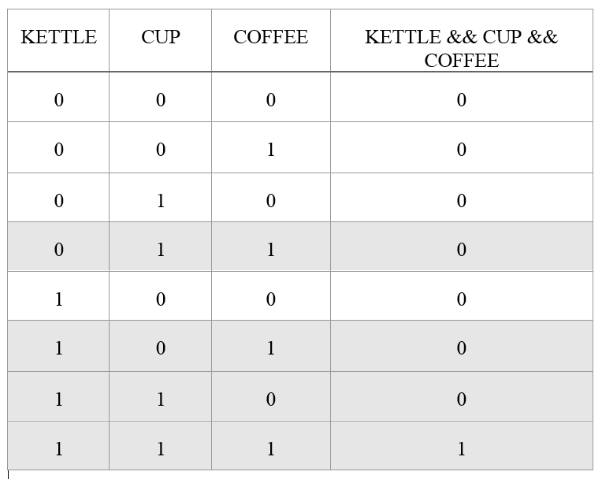
EXAMPLE 2 (Continued)
KETTLE can alter the result independently as shown in test number 4 & 8.
CUP can alter the result independently as shown in test number 6 & 8.
COFFEE can alter the result independently as shown in test number 7 & 8.
Hence, we will choose test numbers 4, 6, 7, and 8 as our test cases.

Slide 10
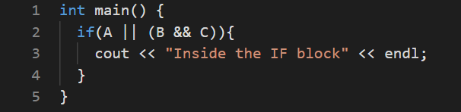
EXAMPLE 3

Slide 11
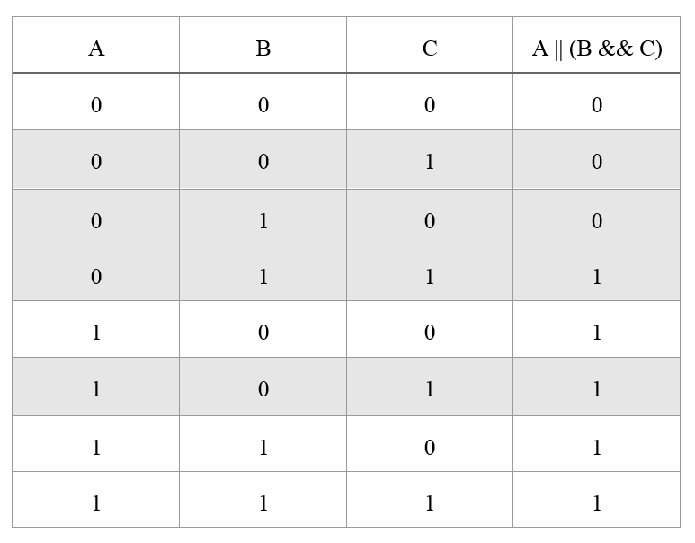
EXAMPLE 3 (Continued)
A can alter the result independently as shown in test number 2 & 6.
B can alter the result independently as shown in test number 2 & 4.
C can alter the result independently as shown in test number 3 & 4.
Hence, we will choose test numbers 2, 3, 4, and 6 as our test cases.

Slide 12
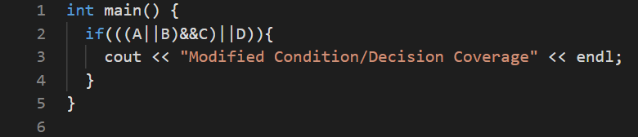
EXAMPLE 4

Slide 13
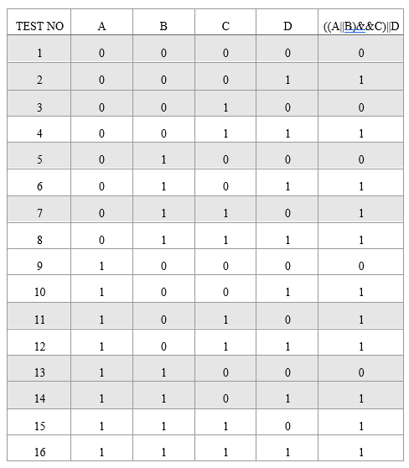
EXAMPLE 4 (Continued)
A can alter the result independently as shown in test number 3 & 11.
B can alter the result independently as shown in test number 3 & 7.
C can alter the result independently as shown in test number 1, 3, 5 & 7.
D can alter the result independently as shown in test number 1, 2, 13 & 14.
Hence, we will choose test numbers 1, 2, 3, 5, 7, 11, 13 and 14 as our test cases.

Slide 14
THANK YOU

